Slide 1
Data Structures Workshop
Day 1

Slide 2
About Us!
Anthony Delgado
Major: Computer Science
Classification: Junior
(Not So) Fun Fact: When I took 2436, I basically completely forgot everything from 1437 (So if I can do it, so can you!)
Chris Theradiyil Sabu
Major: Computer Science
Classification: Junior
Fun Fact:

Slide 3
Some Quick Icebreakers!
Name
Major
Classification
Fun Fact/Something You Did in the Summer

Slide 4
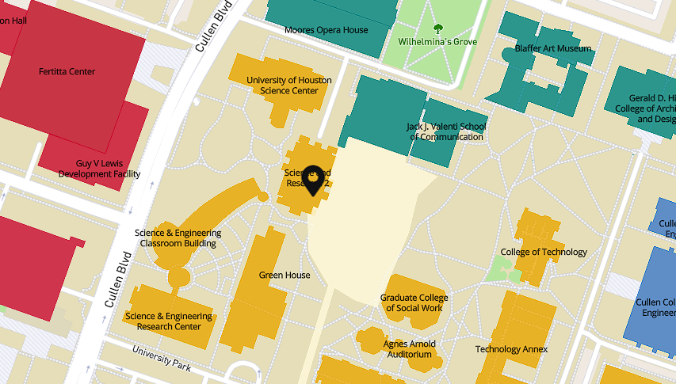
General Course Info
Workshop Facilitators
Anthony Delgado (adelga20@cougarnet.uh.edu)
Chris Sabu (citherad@cougarnet.uh.edu)
Workshop Location
SR2 128 (Tuesday & Thursdays)
Office Hours
To Be Announced

Slide 5


Workshop Overview
This workshop is built around Dr. Rizk’s COSC 2436 course and curriculum
The workshop is a place that:
Creates a positive learning environment
Gives an opportunity for students to work collaboratively
Develops a student’s critical thinking skills
Board work, group work, whole and small-group discussions take place
Builds a student’s study skills (note-taking, outlines, mock exams)

Slide 6
Succeeding in Dr. Rizk’s Class
This class is known for being a “weedout” class in the CS pathway, so it’s important that you don’t neglect it and truly do your best to learn the material covered in class.
As your workshop facilitators, we want each of you to pass the class with the highest grade possible, so please don’t take our class advice/tips lightly (We’ve been through this course and know what to expect). We’re here to make your experience through 2436 as enjoyable as possible.
Come to class & workshop and take notes!​
Keep up with lecture and course materials​
Familiarize yourself with Dr. Rizk’s Linux server, download Putty and FileZilla​ ASAP
Complete extras and upload them to the server for extra credit​
Do as many practice problems as possible on your own outside of class to familiarize yourself with all the concepts and improve your programming skills​

Slide 7
Helpful Resources​
LeetCode & NeetCode​
A programming website that provides over 1000 different practice problems. ​
Helpful in preparing for technical interviews, as many of the questions asked in interviews will be LeetCode type problems. ​
Make sure to set up an account!​
Kattis ​
Archive of programming problems used in many coding competitions​
Like LeetCode, Kattis is very helpful in developing and practicing your programming skills​
Dr. Rizk hosts monthly competitions that can help boost your grade. ​
Additionally, UH’s CSGirls & Cougarettes hosts bi-weekly competitions, which can boost your grade as well. ​
Abdul Bari​ , Jenny
You can just search them up on YouTube. They cover the basic information plus the implementation of each topic well.

Slide 8
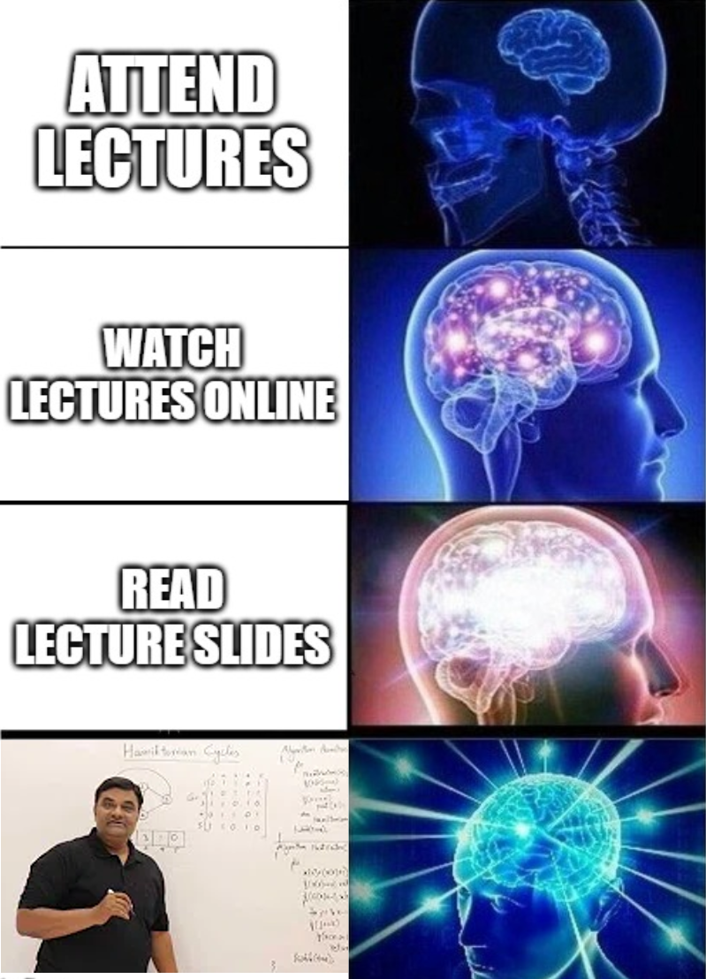
Important Info
Attendance
Participation
This is a difficult class, so please reach out to us for help
IF you decide to drop the lecture:​
'W' Policy​
You may still be enrolled in the workshop, but the highest grade you can receive is a C+

Slide 9
Suggestions?
We’ve gone over some expectations we have of you all for this workshop, but we’d also like your input on some things so we all have a good semester together!
Write down your expectations for this workshop:
What goals do you have from attending workshop?​
Is there anything specific you'd like to see from workshop?​
Why did you join this workshop?​
We value your input and opinions!​

Slide 10
Reviewing C++ Principles​
It’s time for you all to brush up on some 1437 material!
Most Important Things to Brush Up On:
Functions
Pointers
Memory Management​
Arrays​
Structs/Classes
File I/O​
These are crucial to be successful in HW and Programming Assignments!​

Slide 11
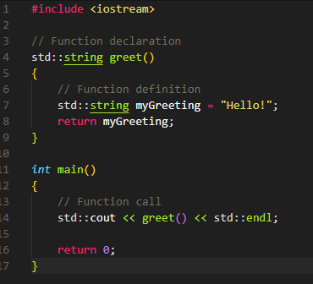
Functions
A function is a block of code that performs a specific task, such as calculating the area of a rectangle or even something as simple as printing “Hello!”
A C++ function consists of two parts:
Declaration: the return type, name of the function, and parameters (if any)
Definition: the body of the function (code to be executed)
Important Takeaways:
Return Type - specifies the type of value or object returned by the function​
Function Name - indicates name given to function
Argument List - placeholder for values that will be passed to function
Function Body - defines the actual performed computations

Slide 12
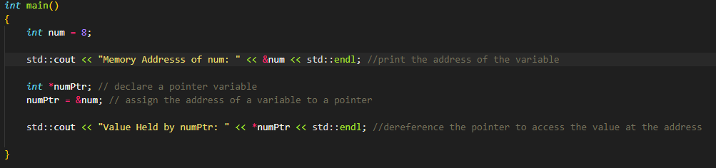
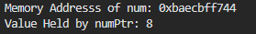
Pointers
Each program variable is stored in the computer’s memory at some location, or address. A pointer is a variable that holds such an address.​
Example: For an int data type, int * denotes a pointer to a variable of type int
Two essential operators used to manipulate pointers:
& - address of operator
* - dereferences the pointer.
Good Resources to Review:
https://www.programiz.com/cpp-programming/pointers

Slide 13
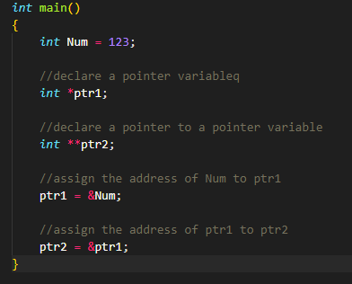
Pointers (cont’d)
int Num – variable of type int​
int *ptr1 – pointer variable of type int​
int **ptr2 – double pointer variable​
* – dereferences a variable​
& – address operator​
0xFF43​
0xB1A2​
0x7714​
ptr2
0xB1A2​
ptr
0x7714​
num
123

Slide 14
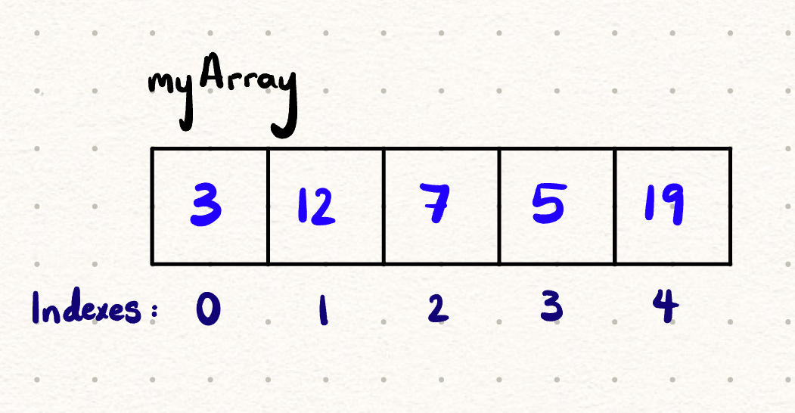
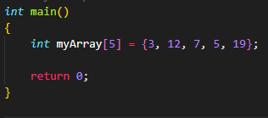
Arrays
An array is a collection of elements of the same type. Arrays are declared with a fixed size, N. Each element of an array is referenced by its index, a number from 0 to N - 1​
Once an array is declared, you cannot increase the number of elements it can store

Slide 15
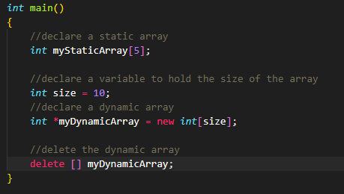
Dynamically Allocated Arrays
C++ requires that a static array have its size defined at compile time. The issue though is that here may be cases where the memory needs of a program can only be determined during runtime (ex. Depending on user input). In these cases, the program needs to dynamically allocate memory.
The new keyword allows for that problem to be solved.
Failure to delete dynamically allocated objects can cause problems.
Good Resources to Review:
https://cplusplus.com/doc/tutorial/dynamic/
https://www.programiz.com/cpp-programming/memory-management

Slide 16
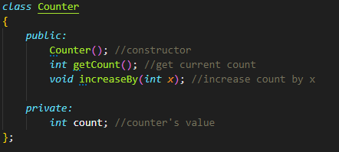
Classes/Structs
Classes are a way to create new user-defined types, with its own set of (member) functions and data members.​
Classes are fundamental to programming that uses an object-oriented approach​
Public Members - can be accessed from outside the class
Private Members - can NOT be accessed (or even viewed) from outside the class
Classes help utilize different computer science techniques such as:​
- Polymorphism - Encapsulation​
- Abstraction - Inheritance
Good Resources to Review:
https://www.programiz.com/cpp-programming/object-class
https://www.w3schools.com/cpp/cpp_classes.asp
Notes:
Classes members are private by default, structs members are public by default

Slide 17
End of Day 1!
Next Workshop:
File I/O (ArgumentManager.h)
FileZilla & PuTTY (Dr. Rizk’s Linux Server)
Recursion
Welcome to 2436! I wish you all luck this semester!

